Slide 1
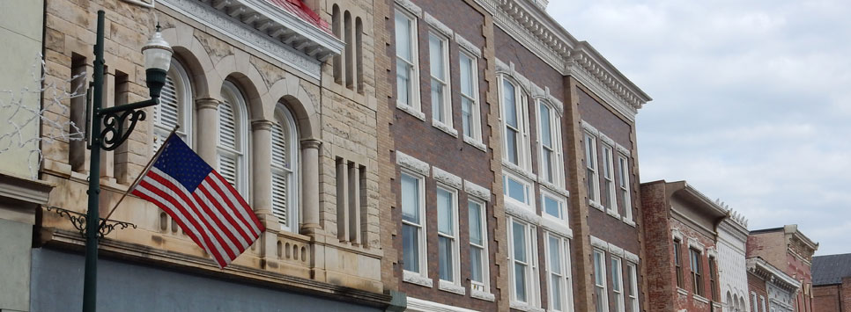
CDBG Downtown Commercial Rehabilitation
Kansas Department of Commerce

Slide 2

What is CDBG Downtown Commercial Rehabilitation?
CDBG Downtown Commercial Rehabilitation is in place to help cities improve the quality of their downtown commercial districts by assisting private property owners in the rehabilitation of blighted buildings. The goal is that the strategic investment of grant funds will help prevent the spread of blighted conditions to other nearby structures.

Slide 3

General Overview
Slum and Blight or LMI Job National Objective
Limit of one building per application
Only for-profit buildings
Applicant will be the local unit of government

Slide 4
Funding Details
Applications accepted January 4, 2021 – December 3, 2021
$1,000,000 set aside for Slum and Blight
$1,000,000 set aside for Job Creation and Retention
Maximum Grant amount $250,000
25% match required by private owner of building

Slide 5
What is Slum and Blight?
Undertaken on a spot basis to eliminate specific conditions of blight, physical decay or environmental contamination
  Historic preservation, rehabilitation of building or improvements; acquisition, clearance, relocation, remediation of environmentally contaminated properties.
Application must pass a resolution declaring the building a blight and indicate the specific conditions that pose a threat to public health and safety

Slide 6
What is Job Creation and Retention?
Who are the beneficiaries?
    The employees that are hired or whose jobs are retained as a result of the CDBG grant
At least 51% of the beneficiaries (employees) being hired or retained must meet HUD’s LMI standard
Job creation refers to the business entity’s (and affiliates) net increase in its permanent labor force in Kansas on a full-time equivalent basis
Job retention refers to those jobs that would be lost if the business fails to receive assistance from the CDBG program

Slide 7
What is Job Creation and Retention?
Follows the same rules as the regular CDBG ED program
1 FTE for every $35,000 of CDBG dollars
  7 jobs created or retained = $245,000 grant
  4 of those job must meet LMI
LMI income status is to be made based on income at the time the CDBG assistance is provided (Previous 12 months)

Slide 8
Limitations
Limited to improvement of exterior of building, asbestos abatement, Lead based paint evaluation and reduction, and correction of code violations
Historic preservation of building must comply with standards set by the Secretary of Interior
Must contact Kansas Historical Society
  Clearance for application
  Final Clearance

Slide 9
Application Narratives
Community needs
  Discuss community needs and how these needs were determined. Also, discuss what actions the community has undertaken to address these needs.
Efforts of community to revitalize downtown district
  Discuss past and present actions of local government, private organizations, and individual property owners to revitalize the commercial district
Scope of work and its impact on Commercial District
Financial capacity and business experience of owner/operator
Business Plan for Reuse of Building
Readiness to proceed

Slide 10
Private Owner
Business Plans for building occupants
Commitment letter from owner outlining building improvements, costs and matching funds
Recapture provisions – 3 year pay-back if the building is sold

Slide 11
Single Phase Project
All work on a commercial building will done in one phase under one contract
    - CDBG and owner pay to address code violations and exterior work
    - Owner pays to address other building rehabilitation work

Slide 12
Multiple Phase Project
Phase I: CDBG and the owner will pay to address code violations and exterior work under one contract
  Phase II: Owner pays to address other building rehabilitation work after the close of Phase I
Owner must show plans and financial resources to undertake Phase II of a renovation
Owner will need to sign an agreement committing to complete Phase II
Failure to complete Phase II within one year of closeout of CDBG grant will trigger a payback by the owner

Slide 13
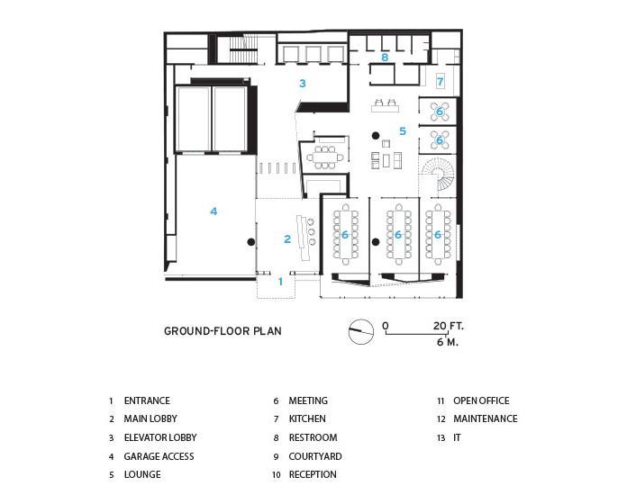
Architectural Firm
Cost estimates must be figured by a licensed architect; to include an itemized breakdown of all renovations

Slide 14

Acquisition
Applicant must follow URA when acquiring any property.
URA= The Uniform Relocation Assistance and Real Property Acquisition Act

Slide 15
Grant Administration
Grant Administration must be procured
Administration fee is $17,000 or 10% of total CDBG funds (whichever is less)

Slide 16

Application Pre-requisites
Historical society approval
  - Initial approval
Asbestos inspection
Preliminary Architectural Report (PAR)

Slide 17
Citizen Participation
Notices must be published in a local newspaper having general circulation in the community.
Notice must be published at least five full days before (starting one day after publication date and not counting the date of the hearing, i.e., a total of seven days).
No more than 20 days before the hearing.
Must contain:
  Detailed project description
  Exact project location
  CDBG grant amount and total project cost

Slide 18
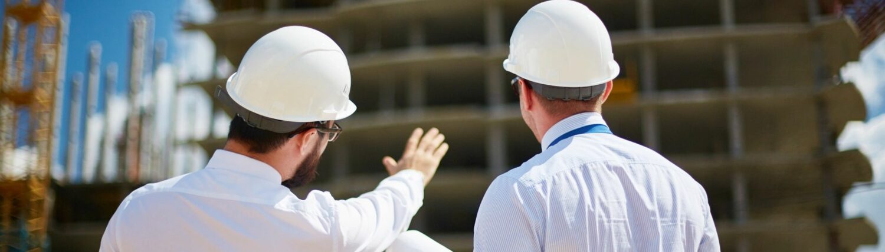
Site Visit
Prior to grant award, applicants will receive a site visit to further evaluate the proposed project

Slide 19

Environmental Review
Environmental Review should be complete and the signed RROF and supporting documents should be submitted within 30 days after application submittal

Slide 20
Program Contact
Dustin Gale
Project Manager
dustin.gale@ks.gov
(785) 296-4100

