Slide 1
USA Aerospace & Defense Showcase

Slide 2
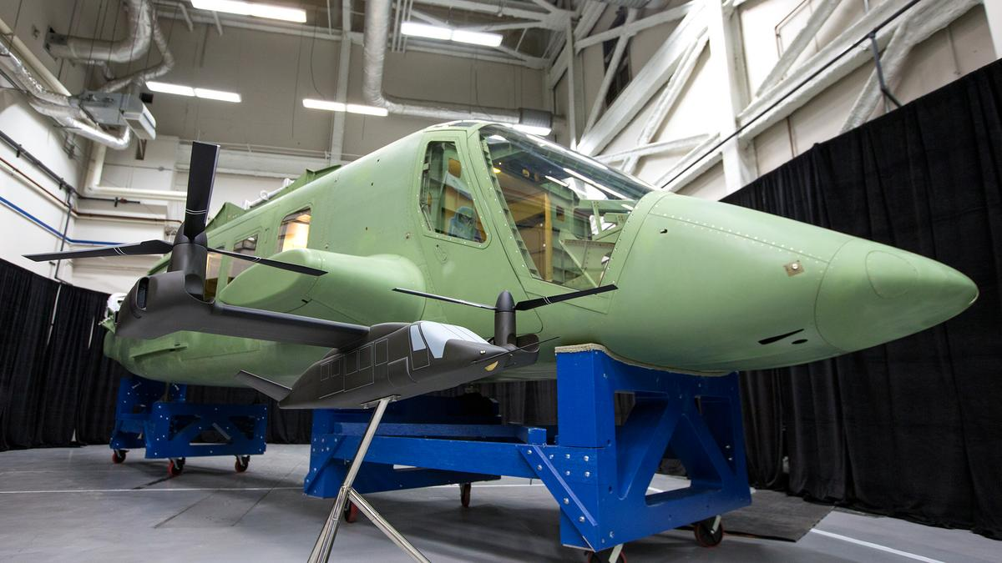
AGENDA
Introduction
Show Overview
Financial Assistance
Q&A

Slide 3
Introduction
Mike Petrassi Kallman Worldwide, Inc.
Tammy Nolan Porazka Greater Wichita Partnership

Slide 4
Financial Assistance
State Trade Expansion Program (STEP)
100% booth and registration reimbursement;
Eligibilities:
Must be a Kansas company and has been in business for not less than one year;
Meets SBA’s small business size standard;
Product must be produced in Kansas or value added in Kansas with at least 51% U.S. content;
Not debarred, suspended, or excluded from participation in transaction by any federal department of agency.

Slide 5
How to Apply www.kansascommerce.gov/STEP
There are four documents in total:
STEP Application Form: Please fill out the form, sign, and date;
SBA Self-Representation as an ‘Eligible Small Business Concern’ Form: Please review, sign, and date;
SBA Form 1624 ‘Certification Regarding Debarment’ Form: Please review, sign, and date;
Kansas STEP Grant Export Readiness Questionnaire: Please fill out the form, sign, and date.
Submit these files via email;
Must apply and be approved before participating in the show.

Slide 6
Q & A
Greater Wichita Partnership
Kansas Department of Commerce
Kallman Worldwide, Inc.
Mike Petrassi
Sales Manager
(202) 251-2600 x 105
mikep@kallman.com
Tammy Nolan Porazka
Vice President of Business Development
(316) 268-1128
Tammy@greaterwichitapartnership.org
Chang Lu
Business Recruitment & International Trade Project Manager
(913) 515-8541
Chang.Lu@ks.gov

