Slide 1


Trade and Investment Expo 2021 Colombia
March 24, 2021

Slide 2

Agenda
Introduction
Show Overview
Financial Assistance
Q&A

Slide 3

Introduction
AmCham Colombia
Jennifer Heredia
Juliana Cárdenas
Valentina Rios
April Chiang
Kathleen Dultmeier
Chang Lu
Kansas Department of Commerce

Slide 4


INTERNATIONAL TRADE EXPO
VIRTUAL
AMCHAM COLOMBIA
June 2 and 3, 2021
9:00 a.m. to 4:00 p.m. ET

Slide 5
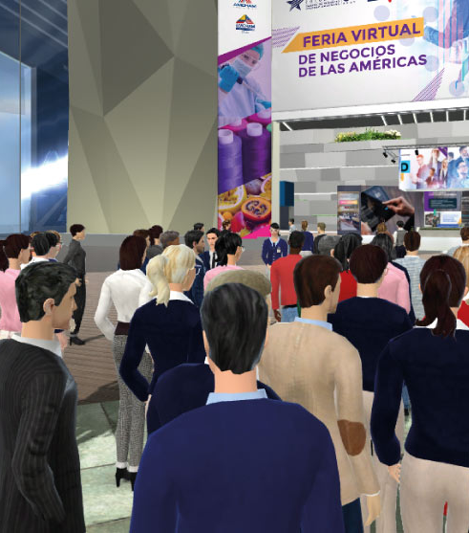
Multi-Sector Virtual Showcase of U.S. and Colombia Leading Products and Services
AmCham Colombia, the official economic and trade development organization for Colombia and the U.S., is pleased to present the third International Trade Expo, a virtual showcase of 100+ of the US and Colombia’s leading products and services providers against more than 500 buyers' attendees from 12 countries.

Slide 6
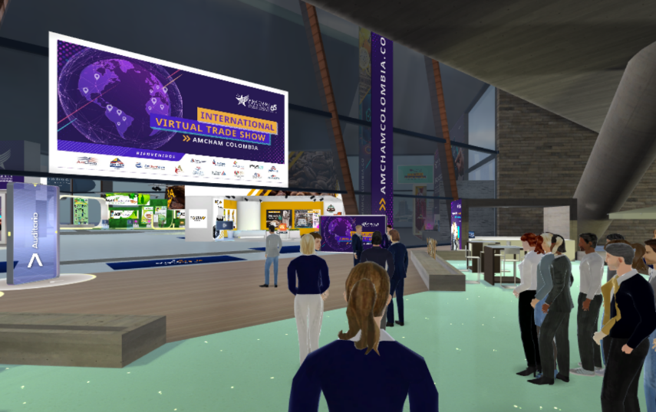
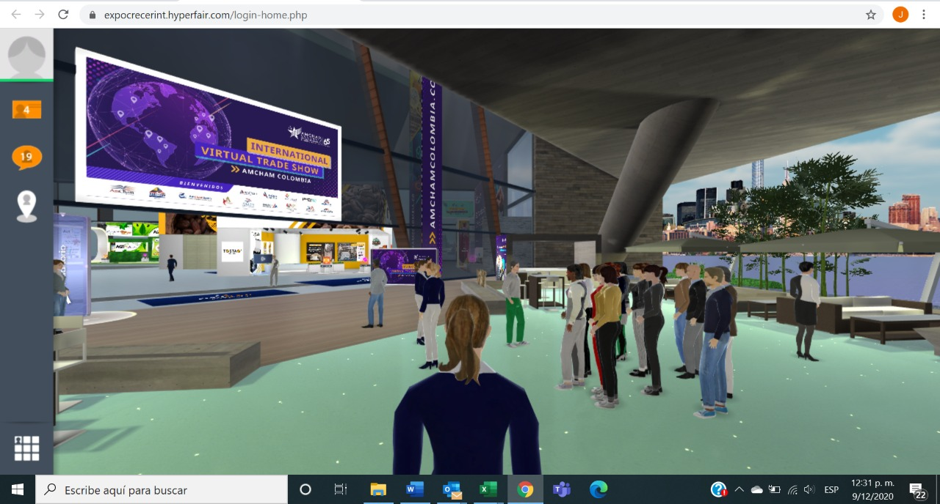
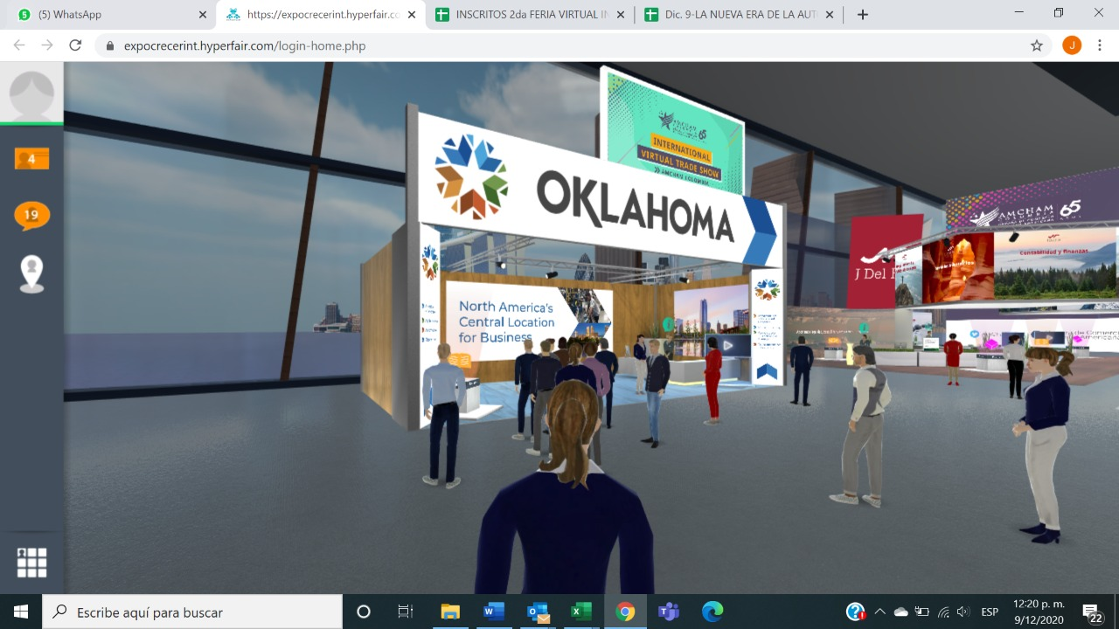
PREVIOUS INTERNATIONAL TRADE EXPO
2020 I
2020 II
112 Exhibitors +1200 International visitors from 16 countries +3800 Interaction through call and chats +1900 One on one meetings +US $25 million expected business
102 Exhibitors +1000 International visitors from 16 countries +3500 Interaction through call and chats +1800 One on one meetings +US $21 million expected business

Slide 7







PRODUCTS & SERVICES
CATEGORIES
LEADING PRODUCTS AND SERVICES PROVIDERS of in six key economic sectors for business RECOVERY and STRENGTHENING with more than 500 BUYERS in value chains for:
AGRIBUSINESS & FOOD
CONSTRUCTION & INFRAESTRUCTURE
MANUFACTURE
PHARMA & COSMETICS
TECNOLOGY & COMMUNICATION
SERVICES

Slide 8












GUEST COUNTRIES
Leading products and services providers and more than 500 agents, distributors, buyers, representatives, and wholesalers seeking high-quality products for distribution and sale in U.S. and Latin America and the Caribbean.

Slide 9
TRADE OPPORTUNITIES BETWEEN
STATE OF KANSAS AND COLOMBIA
TOTAL EXPORTS
2019: 83 MILLION DOLLARS
2020: 43 MILLION DOLLARS
TOP 10 KANSAS EXPORTS TO COLOMBIA
INDUSTRIES | ANNUAL 2019 | ANNUAL 2020
INDUSTRIAL MACHINERY, INCLUDING COMPUTERS | 11,329,259 | 5,310,611
AIRCRAFT, SPACECRAFT, AND PARTS THEREOF | 11,112,280 | 11,703,790
DAIRY PRODS; BIRDS EGGS; HONEY; ED ANIMAL | 17,978,636 | 2,413,571
ELECTRIC MACHINERY ETC; SOUND EQUIP; TV EQUIP; PTS | 7,214,321 | 9,682,359
PHARMACEUTICAL PRODUCTS | 3,232,724 | 2,577,853
MEAT AND EDIBLE MEAT AFFAL | 1,244,214 | 1,231,840
FOOD INDUSTRY RESIDUES & WASTE; PREP ANIMAL FEED | 118,152 | 304,953
TANNING & DYE EXT ETC; DYE; PAINT; PUTTY ETC; INKS | 1,427,460 | 1,177,742
MISCELLANEOUS EDIBLE PREPARATIONS | 5,690,946 | 405,627
OPTIC, PHOTO ETC, MEDIC OR SURGICAL INSTRUMENTS ETC | 1,567,515 | 1,709,506
WORKS TRUCKS AND FORKLIFTS
MEAT OF BOVINE ANIMALS
TECHNOLOGY MACHINES
ANIMAL FEED PREP
EXPORT PRODUCTS
VACCINES FOR VETRINARY MEDICINE
FOOD PREPARATIONS

Slide 10



EXHIBITORS
 | BOOTH | ONE ON ONE MEETINGS | CONFERENCES | UX USERS
SILVER US $ 460
GOLD US $ 540
BUYERS |  | *
4 meetings
US $ 300
6 meetings
US $ 300
IT DOESN´T INCLUDE
TRANSLATION SERVICE

Slide 11
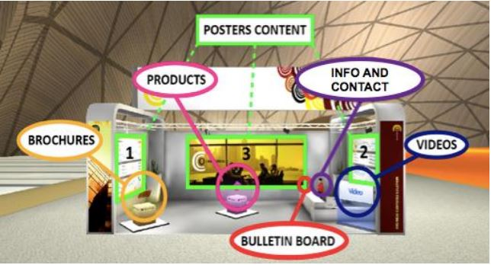
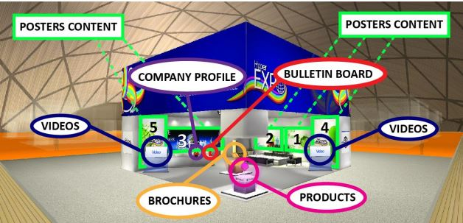
BOTH SET UP INSTRUCTIVE
The material of the Booth must be sent on Friday, May 7th, 2021.
SILVER BOOTH
GOLD BOOTH
AmCham Colombia will set up your Booth!

Slide 12
AGENDA
Wednesday 2, June 2021
Thursday 2, June 2021
08:30 am Exhibition Grand Hall Opens
09:00 am Welcome and Trade opportunities US - LATAM Panel
10:00 am Exhibition UX Users, Meetings & Networking
08:30 am Exhibition Grand Hall Opens
09:00 am Welcome Business Round
10:00 am Exhibition, Meetings & Networking
04:00 pm Closure

Slide 13
REGISTER DEADLINE FOR EXHIBITORS: April 16, 2021
ACTIVITY | DATE
HAND OVER BRANDED MATERIAL FOR BOOTH | May 7, 2021
POTENTIAL COMPANIES SELECTION | May 14, 2021
HAND OVER MATCHMAKING SCHEDULING | May 29, 2021
PARTICIPANTS TRAINING | May 20 and 24, 2021

Slide 14
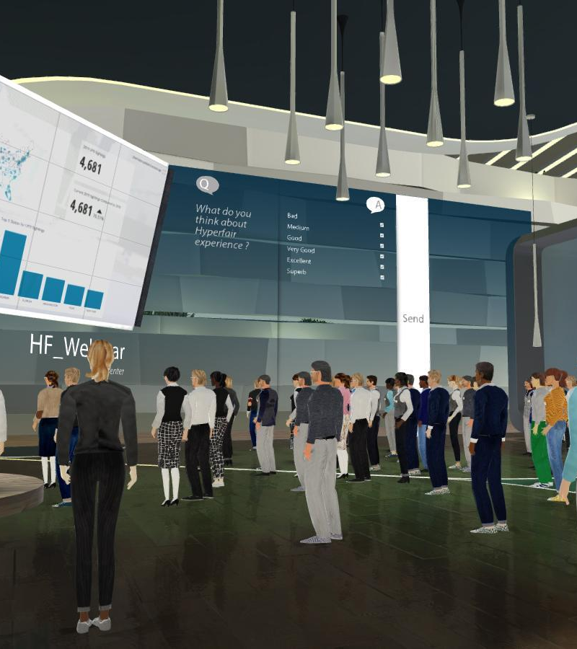
THANK YOU
CONTACT INFORMATION
jcardenas@amchamcolombia.com.co jheredia@amchamcolombia.com.co

Slide 15

Financial Assistance
State Trade Expansion Program (STEP)
  100% booth and registration reimbursement;
Eligibilities:
      Must be a Kansas company and has been in business for not less than one year;
      Meets SBA’s small business size standard;
      Product must be produced in Kansas or value added in Kansas with at least 51% U.S. content;
      Not debarred, suspended, or excluded from participation in transaction by any federal department of agency.

Slide 16

How To Apply
  www.kansascommerce.gov/STEP
  There are four documents in total:
        STEP Application Form - Please fill out the form, sign, and date;
        SBA Self-Representation as an ‘Eligible Small Business Concern’ Form – Please review, sign, and date;
        SBA Form 1624 ‘Certification Regarding Debarment’ Form – Please review, sign, and date;
        Kansas STEP Grant Export Readiness Questionnaire – Please fill out the form, sign, and date.
  Submit these files via email;
  Must apply and be approved before participating in the show.

Slide 17
Q&A
AmCham Colombia
Juliana Cardenas
    New Business Development Executive
    jcardenas@amchamcolombia.com.co
(571)587.7828 Ext: 1215
Jennifer Heredia
    New Business Development Director
    jheredia@amchamcolombia.com.co
    (571)587.7828 Ext: 112
Kansas Department of Commerce
Chang Lu
    Business Recruitment and International Trade Project Manager
    Chang.Lu@ks.gov
    913.515.8541

